Slide 1
430.211 Programming Methodology (프로그래밍 방법론)
Taesup Moon
Department of Electrical and Computer Engineering
Seoul National University

Slide 2
Outline
Chapter 3: Functions

Slide 3
Chapter 3 : Learning objectives
Predefined Functions
Functions that are already implemented in C++
Those that return a value and those that don’t
Programmer-defined Functions
Functions that can be defined by a programmer
Defining, Declaring, Calling
Recursive Functions
Scope Rules
Local variables
Global constants and global variables
Blocks, nested scopes

Slide 4
Introduction to Functions
Building Blocks of Programs
Other terminology in other languages:
Procedures, subprograms, methods (Java)
In C++ → functions
I-P-O
Input – Process – Output
Basic subparts to any program
Use functions for these "pieces"

Slide 5
Predefined Functions
Library files contain many predefined functions
Two types:
Those that return a value
Those that do not (void)
To use a predefined function, you must "#include" appropriate library
E.g.,
<cmath>, <cstdlib> (Original "C" libraries)
<iostream> (for cout, cin)

Slide 6
Using Predefined Functions
Math functions
Found in library <cmath>
Most return a value (the "answer")
E.g., theRoot = sqrt(9.0);
Components: sqrt = name of a library function theRoot = variable used to assign "answer" to 9.0 = argument or "starting input" for function
In I-P-O:
I = 9.0
P = "compute the square root"
O = 3, which is returned & assigned to theRoot

Slide 7
The Function Call
Back to this assignment: theRoot = sqrt(9.0);
The expression "sqrt(9.0)" is known as a function call, or function invocation
The argument in a function call (9.0) can be a literal, a variable, or an expression, i.e., followings all allowed sqrt(9.0), sqrt(a), sqrt(a*b)
The call itself can be part of an expression:
bonus = sqrt(sales)/10;
A function call is allowed wherever it’s legal to use an expression of the function’s return type

Slide 8
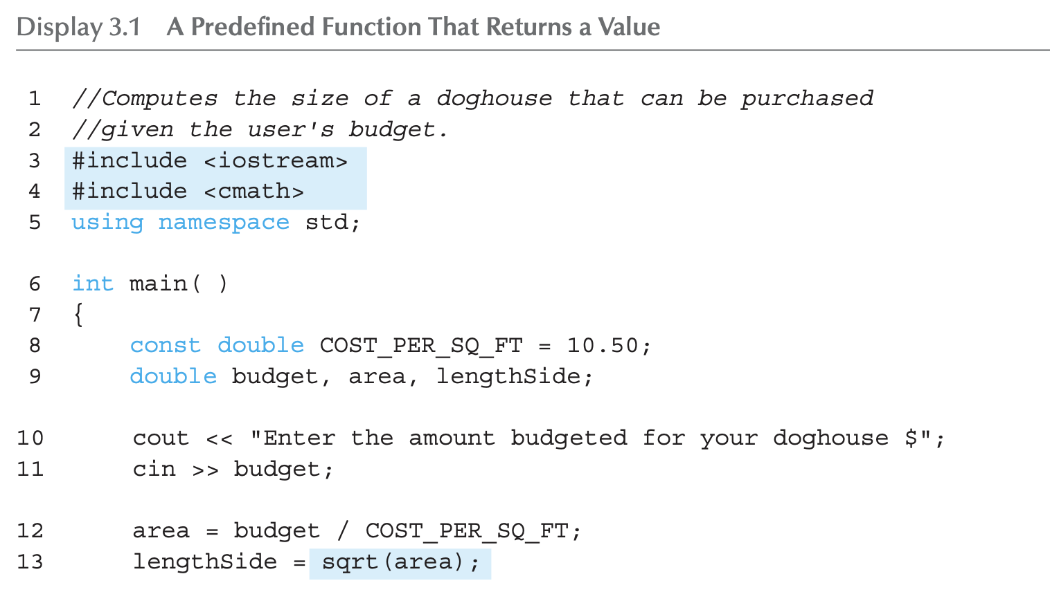
A Larger Example: Display 3.1 A Predefined Function That Returns a Value (1 of 2)

Slide 9
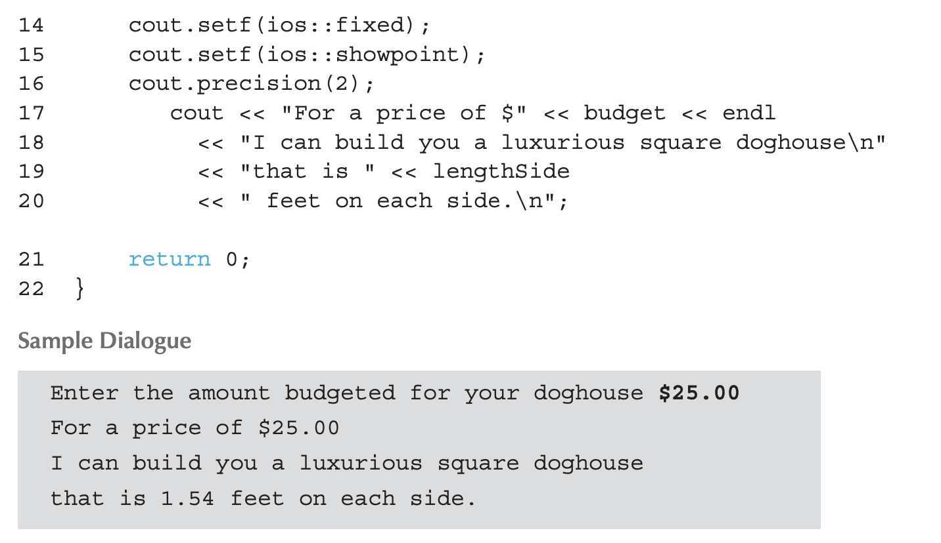
A Larger Example: Display 3.1 A Predefined Function That Returns a Value (2 of 2)
Sets options for printing decimal point

Slide 10
More Predefined Functions
#include <cstdlib>
A library containing functions like:
abs() // Returns absolute value of an int
fabs() // Returns absolute value of a float
fabs() is actually also in a library <cmath>
You must include at least one library containing the function. (It’s fine to include two or more such libraries)
You can refer to manuals/help to find out a library containing a specific function

Slide 11
More Math Functions
pow(x, y)
Returns x to the power y : double answer, x = 3.0, y = 2.0; answer = pow(x, y); cout << answer;
Here 9.0 is displayed since 3.0^{2.0} = 9.0
Notice this function receives two arguments
In fact, a function can have any finite number of arguments of varying data types
No function has more than one value returned! (different from Python)

Slide 12
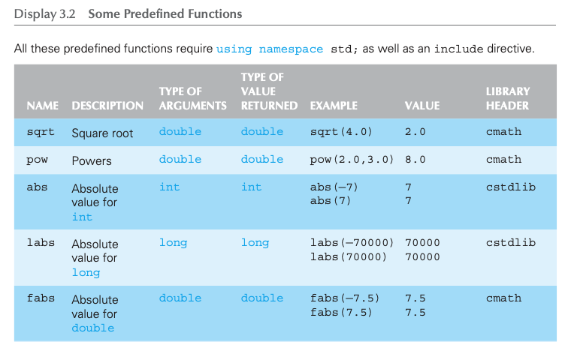
Even More Math Functions: Display 3.2 Some Predefined Functions (1 of 2)

Slide 13
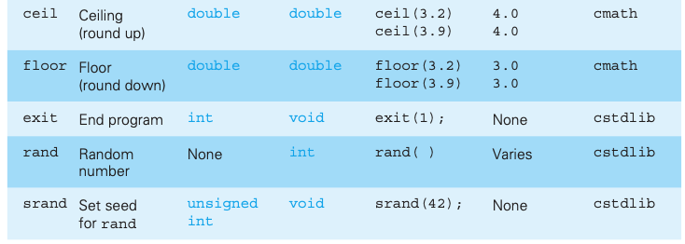
Even More Math Functions: Display 3.2 Some Predefined Functions (2 of 2)

Slide 14
Predefined Void Functions
A function with no returned value
Performs an action, but sends no "answer"
When called, it’s a statement itself
Ex: exit(1); // No return value, so not assigned
This call terminates program
void functions can still have arguments
All aspects are the same as functions that "return a value"
They just don’t return a value!

Slide 15
Random Number Generator
Returns a "randomly chosen" number
Used for simulations, games
rand()
Takes no arguments
Returns a uniform random integer value between 0 & RAND_MAX (= a very large integer constant)
Scaling
Squeezes random number into smaller range Ex: rand()%6
Returns random value between 0 & 5
Shifting
Ex: rand()%6 + 1
Shifts range between 1 & 6 (e.g., die roll)
Real number in [0.0 1.0] (typecasting happening)
(double)(RAND_MAX – rand())/ RAND_MAX

Slide 16
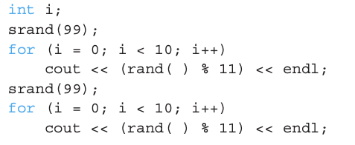
Random Number Seed
Pseudorandom numbers
Calls to rand() produce a fixed "sequence" of random numbers
Use "seed" to alter sequence srand(seed_value);
It is a void function
Receives one argument, the "seed"
Can use any seed value, including system time: srand(time(0));
time(0) returns system time as numeric value
Library <time> contains time() functions

Slide 17
Programmer-Defined Functions
Write your own functions!
Building blocks of programs
Divide & Conquer
Readability
Re-use
Your "definition" can go in either:
Same file as the main() function
Separate file so others can use it, too

Slide 18
Components of Function Use
Three pieces for using functions:
Function Declaration/Prototype
Information for compiler
To properly interpret calls
Function Definition
Actual implementation/code for what a function does
Function Call
Transfer control to function

Slide 19
Function Declaration/Prototype
An "informational" declaration for compiler
Tells compiler how to interpret calls
Syntax: <return_type> FcnName(<formal-parameter-list>);
Example:
Designates the type of the return value, name of the function, number of arguments, type of the formal parameters
Placed before any calls to the function
Above the main() function in global space
Notice the semicolon!

Slide 20
Alternative Function Declaration/Prototype
Compiler only needs to know:
Return type
Function name
Parameter list
Formal parameter names are not needed: double totalCost(int, double);
Can only present the data types of the parameters

Slide 21
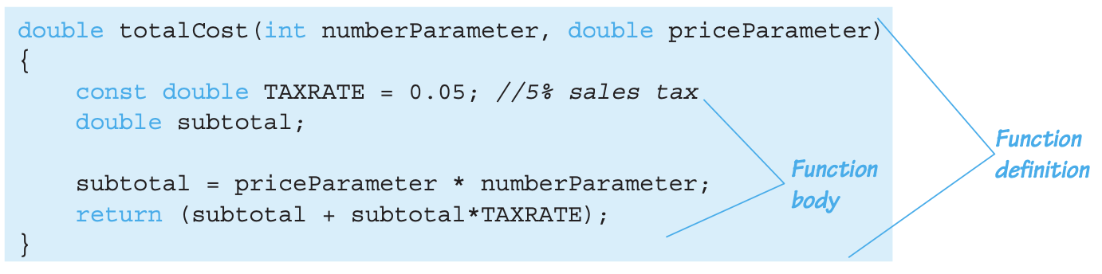
Function Definition
Actual implementation of function
Just like implementing the function main()
Example:
Notice proper indenting

Slide 22
Function Definition Placement
Can be placed after or before the function main()
In case of before, function declaration can be omitted
NOT "inside" the main() function!
Can also be placed in a separate file
The separate file can be named with .cpp extension
The function declaration can be placed in another header file #include “XXX.h” (or “XXX.hpp”)
Examples are given later

Slide 23
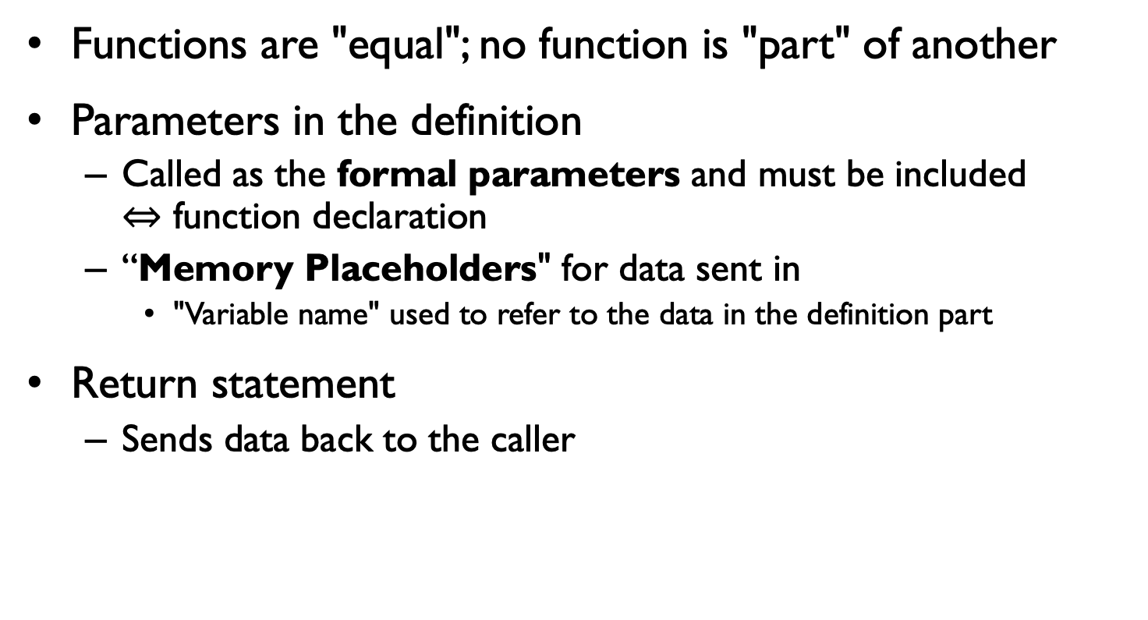
Function Definition Placement
Functions are "equal"; no function is "part" of another
Parameters in the definition
Called as the formal parameters and must be included $⇔$ function declaration
“Memory Placeholders" for data sent in
"Variable name" used to refer to the data in the definition part
Return statement
Sends data back to the caller

Slide 24
Function Call
Just like calling a predefined function bill=totalCost(number, price);
Recall: totalCost returns a double value
Assigned to variable named "bill"
Arguments here: number,price
Arguments can be literals, variables, expressions, or their combination
In a function call, arguments often called as "actual arguments"
Because they contain the "actual data" being sent

Slide 25
A simple example: Order matters
int volume(int h, int w, int l) { return h*w*l; }
int area(int h, int w, int l) { return 2*(h*w + w*l + l*h); }
void main() {
std::cout << "The volume of box1 is “<< volume(3,5,7) << std::endl;
std::cout << "The area of box1 is " << area(3,5,7) << std::endl;
std::cout << "The area of box2 is " << area(10,20,30) << std::endl;
std::cout << "The area of box3 is " << area(15,25,35) << std::endl;
}
OK
void main() {
std::cout << "The volume of box1 is “<< volume(3,5,7) << std::endl;
std::cout << "The area of box1 is " << area(3,5,7) << std::endl;
std::cout << "The area of box2 is " << area(10,20,30) << std::endl;
std::cout << "The area of box3 is " << area(15,25,35) << std::endl;
}
int volume(int h, int w, int l) { return h*w*l; }
int area(int h, int w, int l) { return 2*(h*w + w*l + l*h); }
error

Slide 26
A simple example: Function declaration/prototypes
#include <iostream>
int volume(int h, int w, int l);
int area(int h, int w, int l);
void main() {
std::cout << "The volume of box1 is “<< volume(3,5,7) << std::endl;
std::cout << "The area of box1 is " << area(3,5,7) << std::endl;
std::cout << "The area of box2 is " << area(10,20,30) << std::endl;
std::cout << "The area of box3 is " << area(15,25,35) << std::endl;
}
int volume(int h, int w, int l) { return h*w*l; }
int area(int h, int w, int l) { return 2*(h*w + w*l + l*h); }
function declarations/prototypes
OK

Slide 27
A simple example: Function prototypes
#include <iostream>
int volume(int, int, int );
int area(int, int, int );
void main() {
std::cout << "The volume of box1 is “<< volume(3,5,7) << std::endl;
std::cout << "The area of box1 is " << area(3,5,7) << std::endl;
std::cout << "The area of box2 is " << area(10,20,30) << std::endl;
std::cout << "The area of box3 is " << area(15,25,35) << std::endl;
}
int volume(int h, int w, int l) { return h*w*l; }
int area(int h, int w, int l) { return 2*(h*w + w*l + l*h); }
function declarations/prototypes (parameter names can be omitted)
OK

Slide 28
A simple example: Function prototypes
A.cpp
modular programming!
#include <iostream>
int volume(int h, int w, int l);
int area(int h, int w, int l);
void main() {
std::cout << "The volume of box1 is “<< volume(3,5,7) << std::endl;
std::cout << "The area of box1 is " << area(3,5,7) << std::endl;
std::cout << "The area of box2 is " << area(10,20,30) << std::endl;
std::cout << "The area of box3 is " << area(15,25,35) << std::endl;
}
B.cpp
int volume(int h, int w, int l) { return h*w*l; }
int area(int h, int w, int l) { return 2*(h*w + w*l + l*h); }
OK
Need to compile two files together!
g++ A.cpp B.cpp –o sample

Slide 29
A simple example: Most recommended way
myheader.h
int volume(int h, int w, int l);
int area(int h, int w, int l);
// and other function prototypes...
A.cpp
#include <iostream>
#include "myheader.h”
void main() {
std::cout << "The volume of box1 is “<< volume(3,5,7) << std::endl;
std::cout << "The area of box1 is " << area(3,5,7) << std::endl;
std::cout << "The area of box2 is " << area(10,20,30) << std::endl;
std::cout << "The area of box3 is " << area(15,25,35) << std::endl;
}
B.cpp
#include "myheader.h” ← Can omit.
int volume(int h, int w, int l) { return h*w*l; }
int area(int h, int w, int l) { return 2*(h*w + w*l + l*h); }
OK

Slide 30
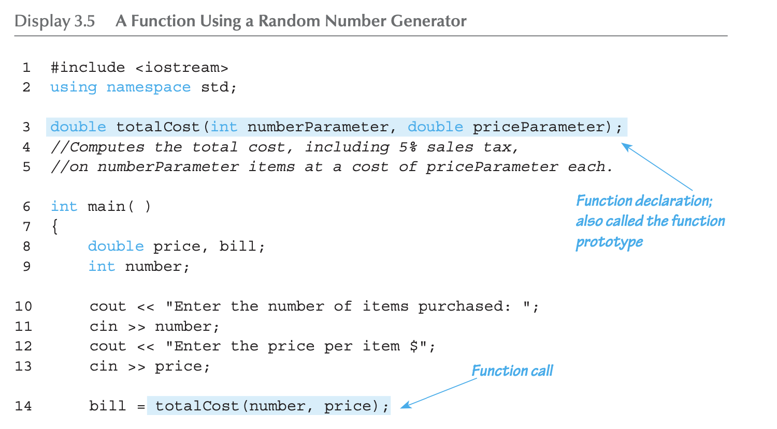
More Function Example: Display 3.5 A Function to Calculate Total Cost (1 of 2)

Slide 31
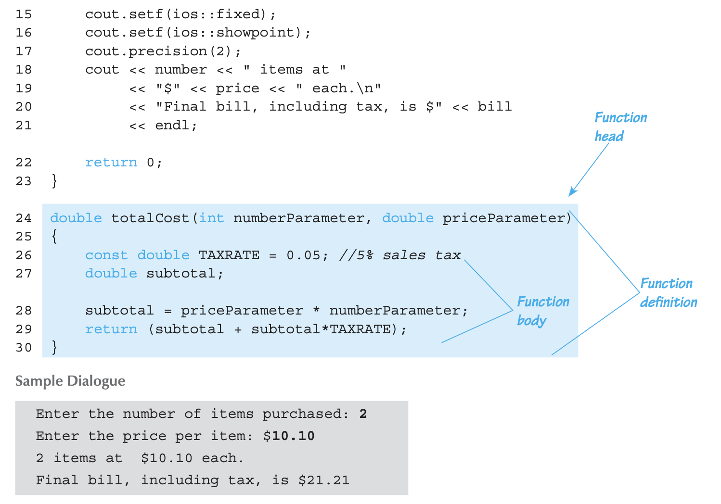
More Function Example: Display 3.5 A Function to Calculate Total Cost (1 of 2)

Slide 32
Parameter vs. Argument
Terms often used interchangeably
Formal parameters/arguments
In function declaration
In function definition’s header
Actual parameters/arguments
In function call
Technically, parameter is "formal" piece while argument is "actual" piece

Slide 33
Functions Calling Functions
We’re already doing this!
main() IS a function!
Only requirement:
Function’s declaration must appear first
Function’s definition is typically elsewhere
After or before main()’s definition
Or in a separate file
Common for functions to call many other functions
Function can even call itself → "Recursion"

Slide 34
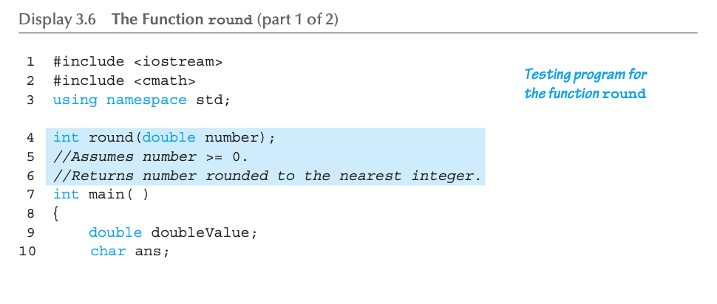
Functions Calling Functions : Display 3.6 round function (1 of 2)

Slide 35
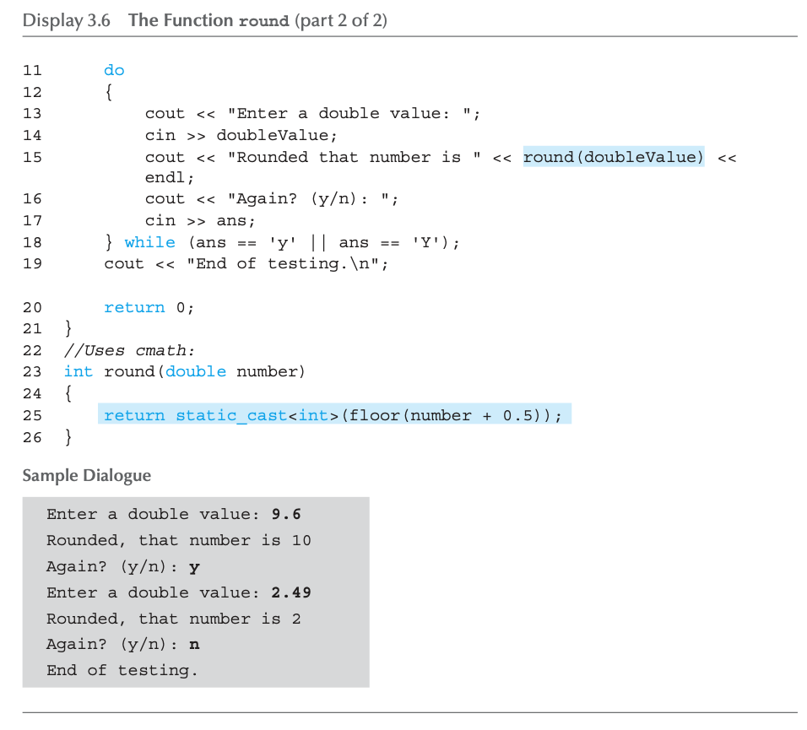
Functions Calling Functions : Display 3.6 round function (2 of 2)
Function calling another function!

Slide 36
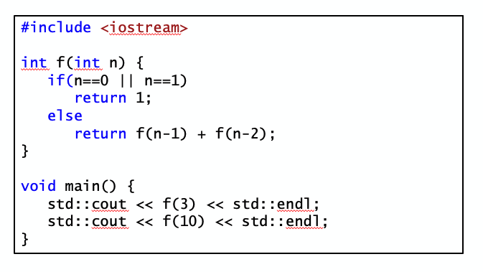
Functions Calling Functions : Recursive function

Slide 37
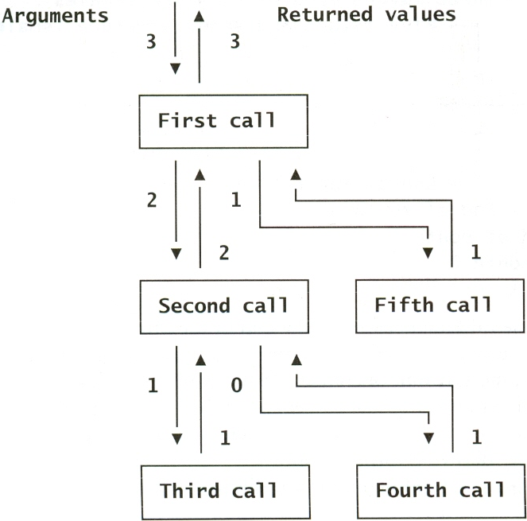
Functions Calling Functions : Recursive function
More in Ch.13 and Project 1!

Slide 38
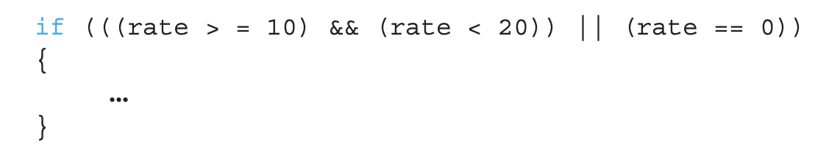
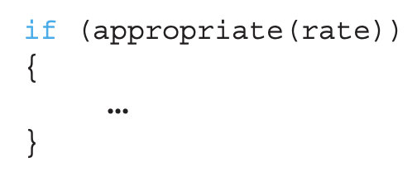
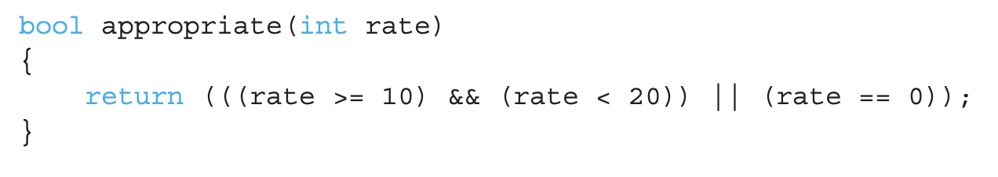
Boolean Return-Type Functions
Return-type can be any valid type, including Boolean
Consider the Boolean expression in
We can utilize function to make it look simpler
Looks complicated & hard to read

Slide 39
Declaring Void Functions
Similar to functions returning a value
Return type specified as "void"
Example:
Function declaration/prototype: void showResults(double fDegrees, double cDegrees);
Return-type is "void"
Nothing is returned

Slide 40
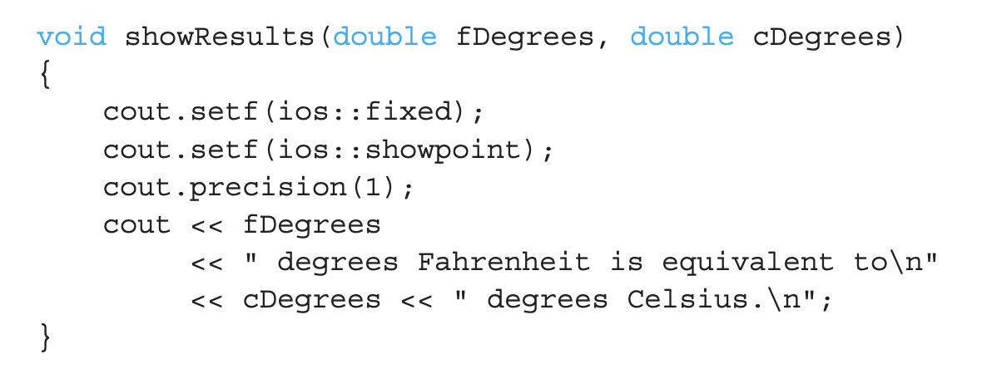
Declaring Void Functions
Function definition
Notice: no return statement

Slide 41
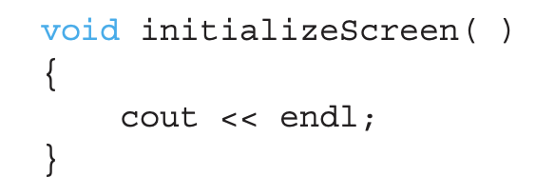
Calling Void Functions
Same as calling predefined void functions
From some other function, like main():
showResults(degreesF, degreesC);
showResults(32.5, 0.3);
Notice no assignment to other variable, since no value is returned
Actual arguments (degreesF, degreesC)
Passed to the function
Function is called to "do its job" with the data passed in
Void function with no argument is perfectly fine!

Slide 42
More on Return Statements
Transfers control back to the "calling" function
Return type other than void MUST have return statement
Typically, the LAST statement in a function definition
return; is an optional statement for void functions
Closing } would implicitly return control from void function

Slide 43
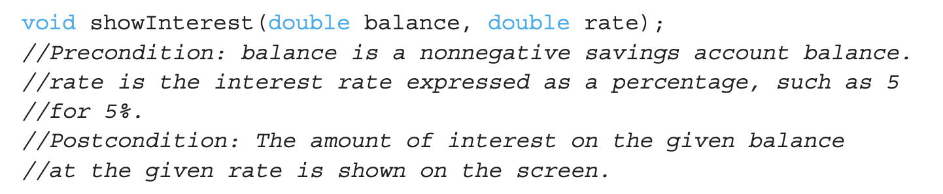
Preconditions and Postconditions
A good way for commenting a function declaration
Similar to "I-P-O" discussion
Comment function declaration to describe the input and output of the function :
Often called Inputs & Outputs

Slide 44
main(): "Special"
Recall: main()IS a function
"Special" in that:
One and only one function called main() will exist in a program
Who calls main()?
Operating system
Tradition holds it should have return statement
Value returned to "caller" → Here: operating system
Should return "int" or "void"

Slide 45
Scope Rules
Local variables
Declared inside the body of given function
Available only within that function
Can have variables with same names declared in different functions
Scope is local: "that function is its scope"
Local variables preferred
Maintain individual control over data
Functions should declare whatever local data needed to "do their job"

Slide 46
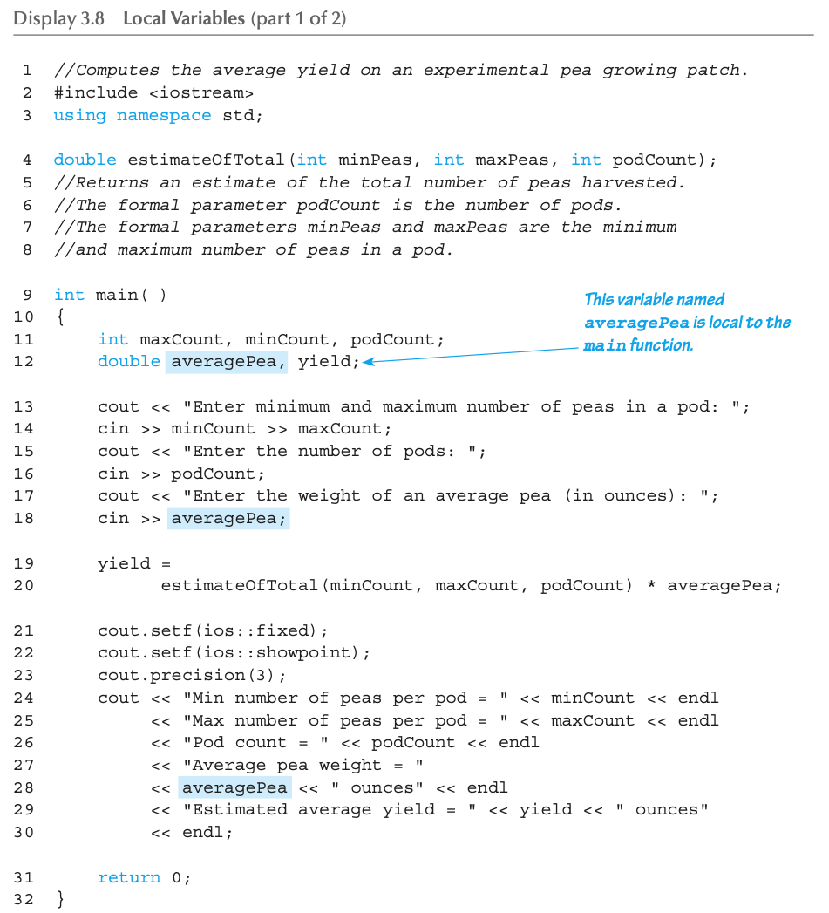
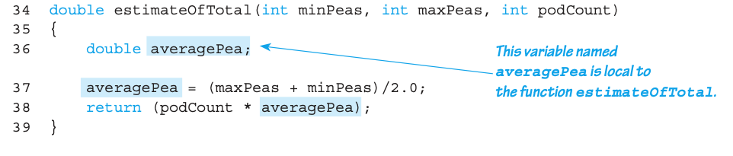
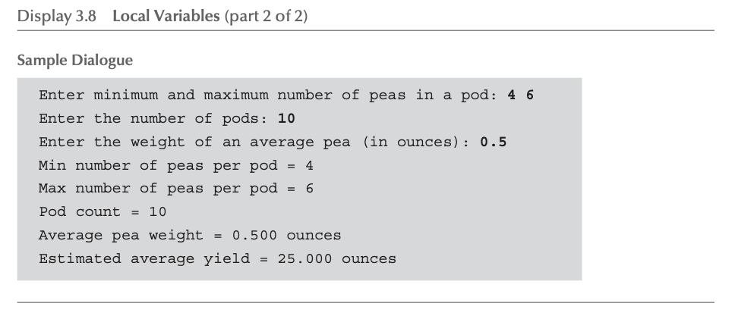
Local variable example

Slide 47
Procedural Abstraction
Need to know "what" function does, not "how" the function does it!
Think it as a "black box"
Device you know how to use, but not its method of operation
Implement a function like a black box
User of a function only needs to know : declaration
Does NOT need to know function definition
Also called as information hiding
Hide details of "how" function does its job

Slide 48
Global Constants and Global Variables
If declared "outside" function body
Global to all functions in that file
If declared "inside" function body
Local to that function
Global declarations are typical for constants:
const double TAXRATE = 0.05;
Declare globally so all functions can use it
Global variables?
Possible, but SELDOM-USED
Dangerous: no control over usage!

Slide 49
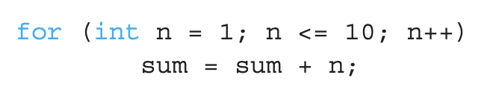
Blocks
Declare data inside compound statement {}
Called a "block"
Has "block-scope"
Note: all function definitions are blocks!
This provides local "function-scope"
Loop block example:
Variable n has scope in loop body block only

Slide 50
Summary 1
Two kinds of functions:
"Return-a-value" and void functions
Functions should be "black boxes"
Hide "how" details
Declare own local data
Function declarations should self-document
Provide pre- & post-conditions in comments
Provide all "caller’s" needs for use

Slide 51
Summary 2
Local data
Declared in function definition
Global data
Declared above function definitions
OK for constants, not for variables
Parameters/Arguments
Formal: In function declaration and definition
Placeholder for incoming data
Actual: In function call
Actual data passed to function

Slide 52
Thank you!
Web: http://mindlab-snu.github.io
E-mail: tsmoon@snu.ac.kr

